Slide 1
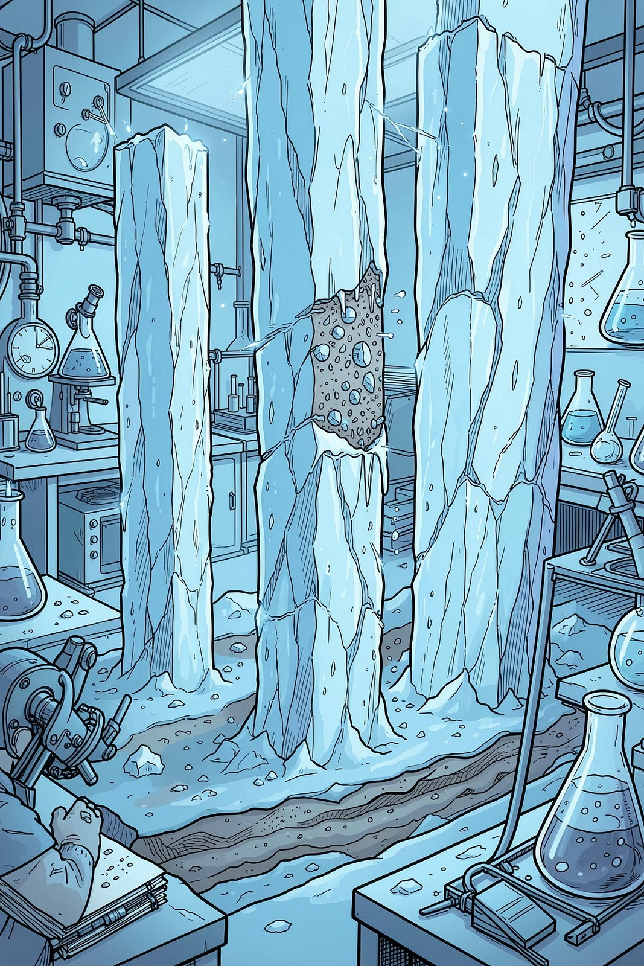

Mastering the Paleoclimatology Research Proposal
GEOG/GEOL/MAST 658 · ACADEMIC LIBRARIAN: MICHAEL STIRM II
A strategic framework for building a rigorous, hypothesis-driven 15-page research proposal — from topic selection to final submission.
Master specialized paleoclimate databases and search tools Develop a refined keyword strategy for complex topics
Apply AGU/AMS citation standards and formatting requirements

Slide 2




Your Project Roadmap
Five milestones guide you from concept to completion. Stay on schedule — each step builds on the last.
Oct 8
Title & Research Paragraph
1
2
Oct 15
5 Preliminary References
Oct 29
Extended Outline
3
4
Nov 10
Rough Draft
Dec 13
Final Paper Due
5

Slide 3
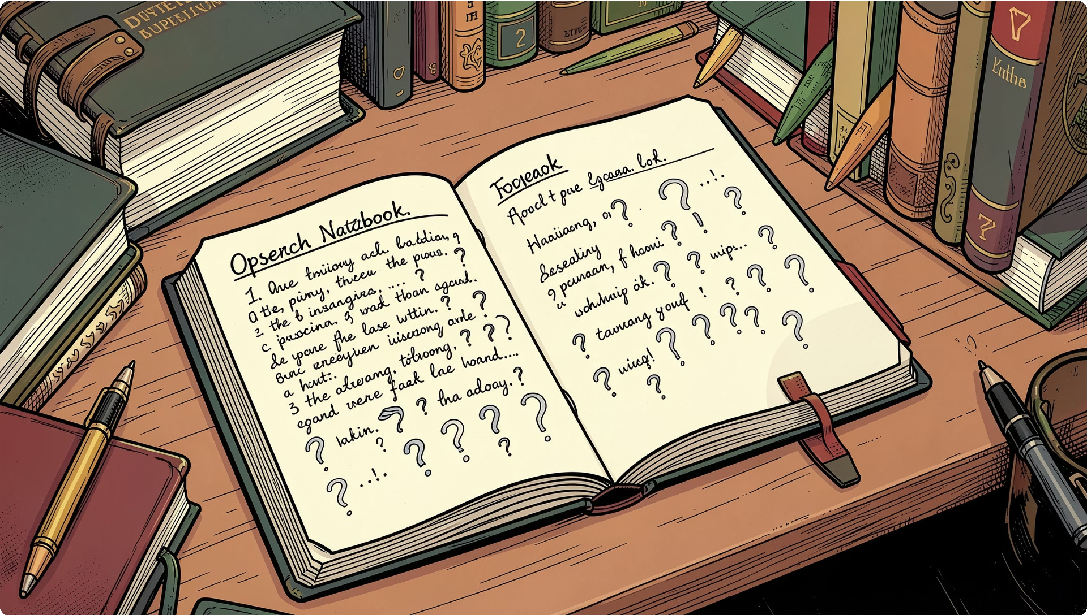
From Topic to Hypothesis
Use the Research Topic Worksheet to narrow broad interests into a focused, testable hypothesis. Start with background research to define scope and terminology.
Start Broad
Identify your general area of interest (e.g., Holocene climate variability)
Build Background
Use Credo Reference for encyclopedic overviews and key terminology
Form the Question
Articulate a specific, falsifiable research question with measurable variables

Slide 4

The Keyword Matrix
Build a Concept and Synonym Table before searching. This ensures you capture relevant literature across varying terminology used in paleoclimate research.
Concept 1 | Concept 2 | Concept 3 | Synonyms / Variants
Paleotemperature | Proxy records | Holocene | δ¹⁸O, alkenones, TEX₈₆
Precipitation | Sediment cores | Last Glacial Maximum | Rainfall, monsoon, aridity
Climate variability | Ice cores | Millennial-scale | Oscillation, cyclicity, anomalies
Combine terms with AND (between concepts) and OR (within synonyms) to refine database searches.

Slide 5
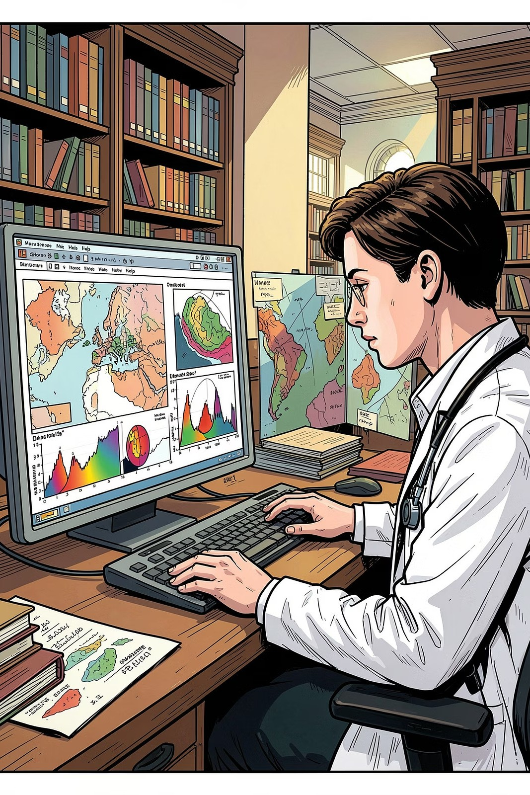








Navigating Specialized Databases
Web of Science
High-impact peer-reviewed journals across all earth science disciplines
Scopus / GEOBASE
Broad coverage of geology, geography, and environmental science literature
GeoRef
The definitive index for geological and paleoclimatology publications
GreenFILE
Environmental policy, climate change impacts, and sustainability research

Slide 6
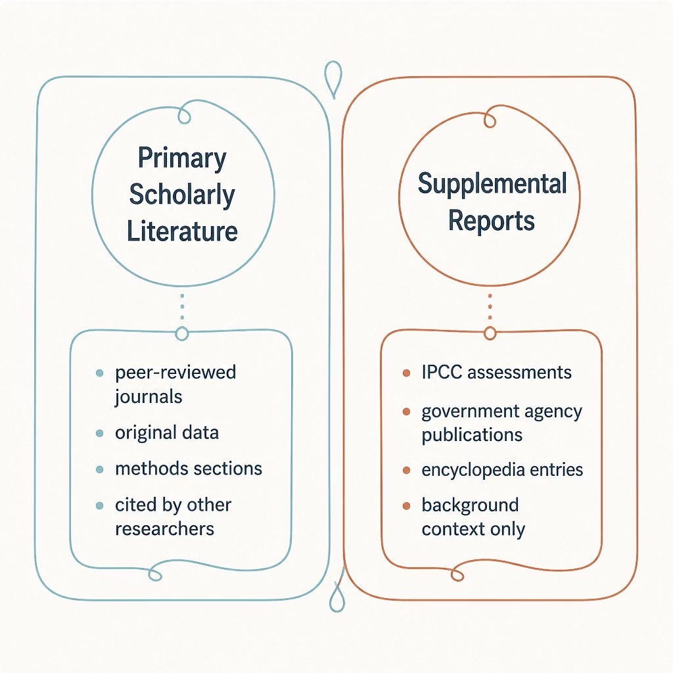
Evaluating Source Quality
Scholarly vs. Supplemental Sources
Your proposal must be grounded in peer-reviewed literature. Supplemental reports (e.g., IPCC assessments) provide context but do not replace primary research articles.
Minimum 10 references required in the final proposal.
✅ Primary Sources
Peer-reviewed journal articles with original data and methods
⚠ Supplemental Sources
IPCC reports, agency publications — useful for framing, not as core evidence

Slide 7
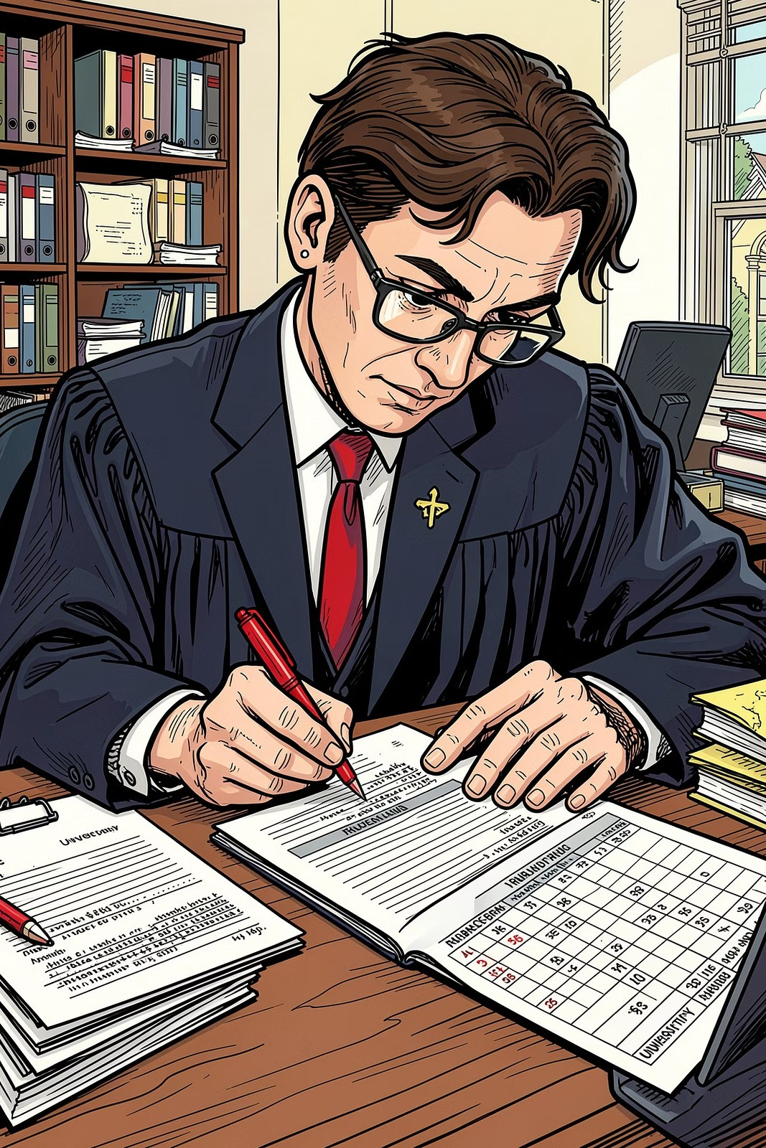



Scoring "Excellent" on Content
The rubric rewards depth, precision, and scientific rigor. Align every section of your proposal with these three criteria.
Technically Sound
Methods and data interpretations must be accurate and consistent with current paleoclimate literature
Objective
Avoid unsupported claims; ground all arguments in cited evidence and acknowledge limitations
In-Depth Analysis
Go beyond description — synthesize sources, identify gaps, and justify your hypothesis clearly

Slide 8
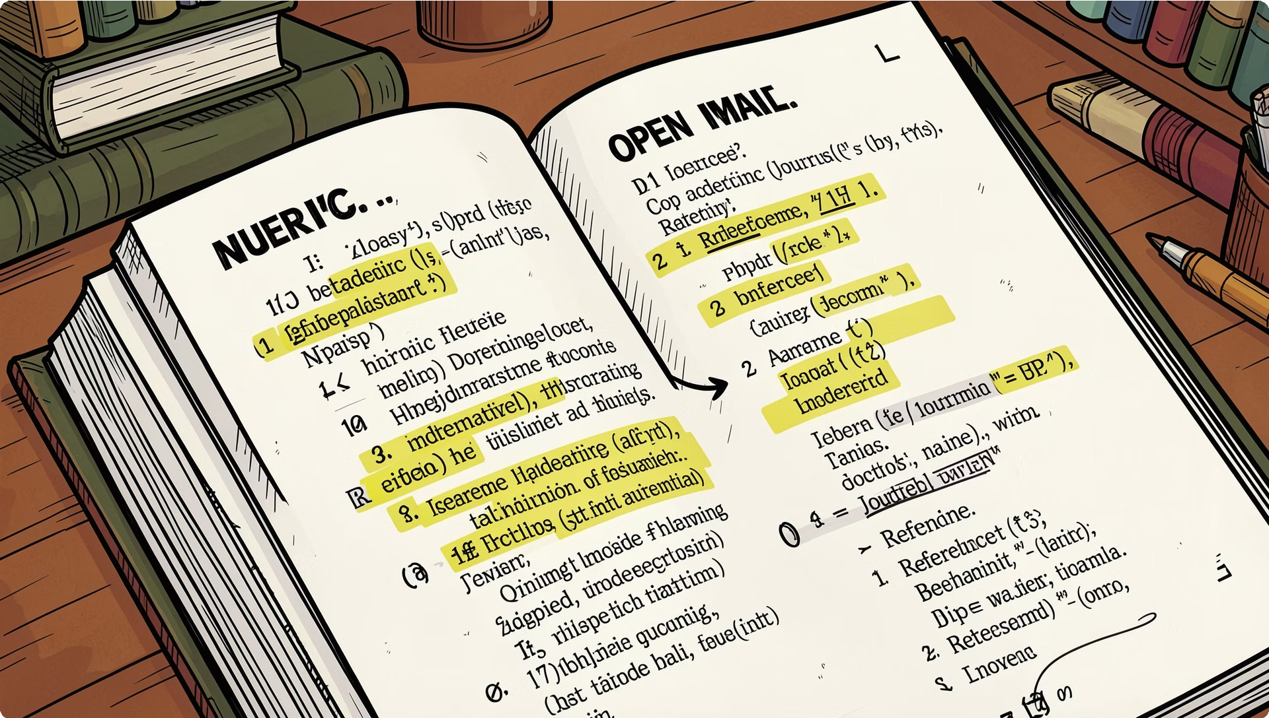


Citation Mastery F Ethics
Consistent citation style is non-negotiable. Your proposal must follow either AGU (American Geophysical Union) or AMS (American Meteorological Society) formatting throughout.
In-Text Citations
Author–year format (AGU) or numbered superscripts (AMS) 4 be consistent
Reference List
Every in-text citation must appear in the references and vice versa
Image Credits
All figures and images require a captioned credit line citing the original source

Slide 9



The Final Checklist
Before submitting, verify every formatting requirement. Non-compliance affects your grade regardless of content quality.
1 2 3
15-Page Minimum
Excludes title page, references, and figures
12-pt Font
Times New Roman or Arial only
1.5 Line Spacing
Applied throughout the entire document
4
5
10+ References
Peer-reviewed sources in AGU or AMS style
Image Credits
Every figure cited with source and permissions

Slide 10
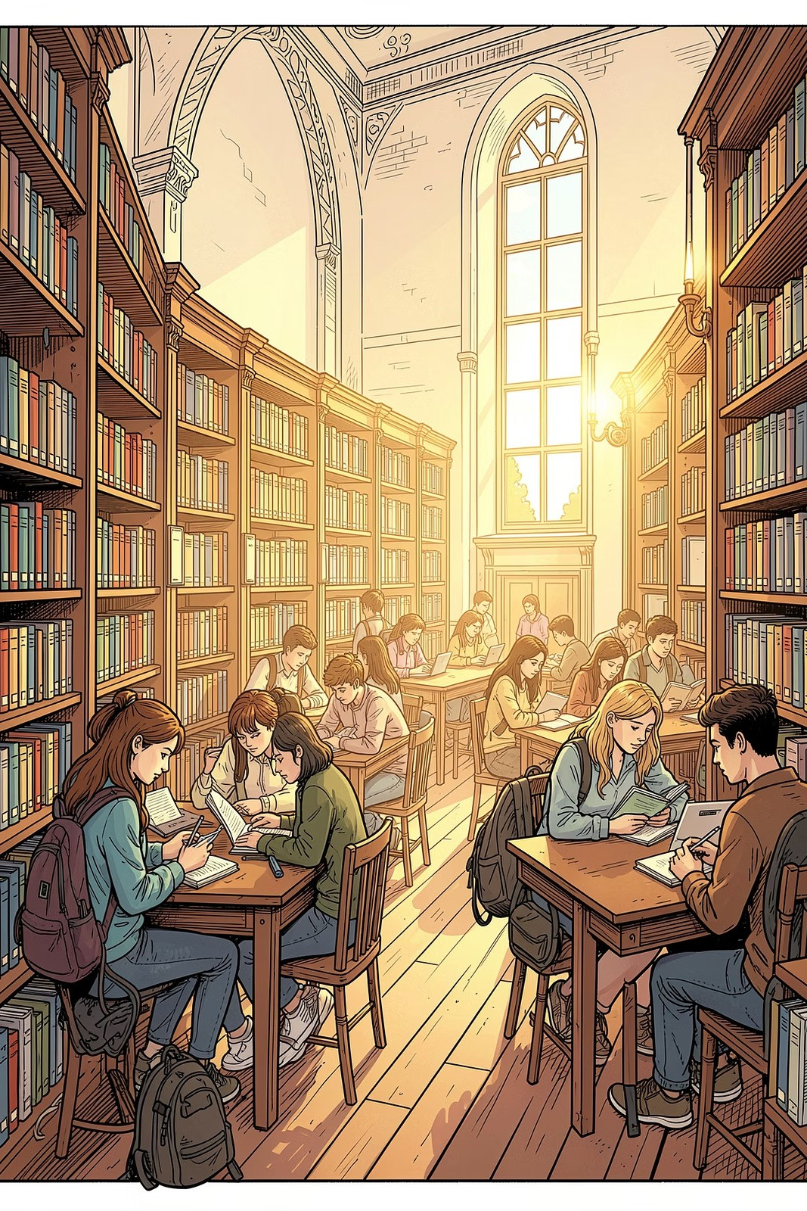


Library Support F Resources
You're not working alone. These resources are available throughout your research process.
Research Support Portal
Live chat, research guides, and database tutorials at researchsupp ort.lovable.app
Eloquent Science Textbook
Practical guidance on scientific writing, figure design, and oral presentation skills — available through the library
One-on-One Consultations
Schedule a personalized research session with Michael Stirm II for targeted proposal feedback

